Slide 1
Case Study Competition – Final Round
Track | Data Visualization
College/University | BANARAS HINDU UNIVERSITY
Software/tool used | PYTHON/POWERBI/EXCEL
Student Name | Email ID | PG Course | Current semester/Year
SRIRAM RAVIKISHOR | sriramravikishor.bhu.comp@gmail.com | MSC STATISTICS AND COMPUTING | 2nd year
NALLI GEETA GAYATRI | geetagayatrinalli.bhu.stcomp@gmail.com | MSC STATISTICS AND COMPUTING | 2nd year
NAGARAJU K | nagaraju.bhu.stcomp@gmail.com | MSC STATISTICS AND COMPUTING | 2nd year
GUIDED BY
Shiva Prasad sir
Jacob Mathew sir

Slide 2
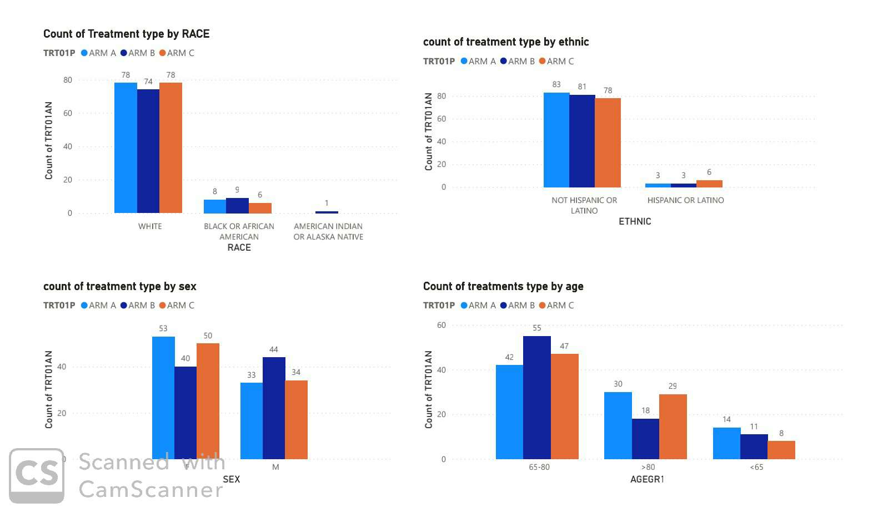
Exploring Demographic characteristics by Treatments

Slide 3
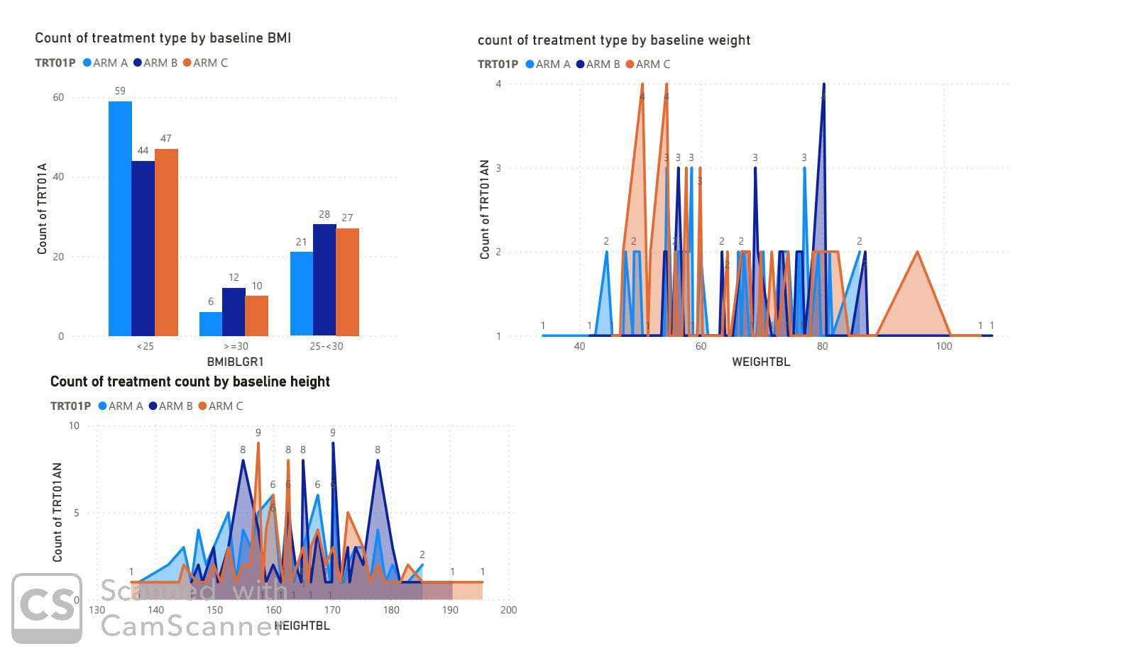
Exploring Baseline characteristics by Treatments

Slide 4
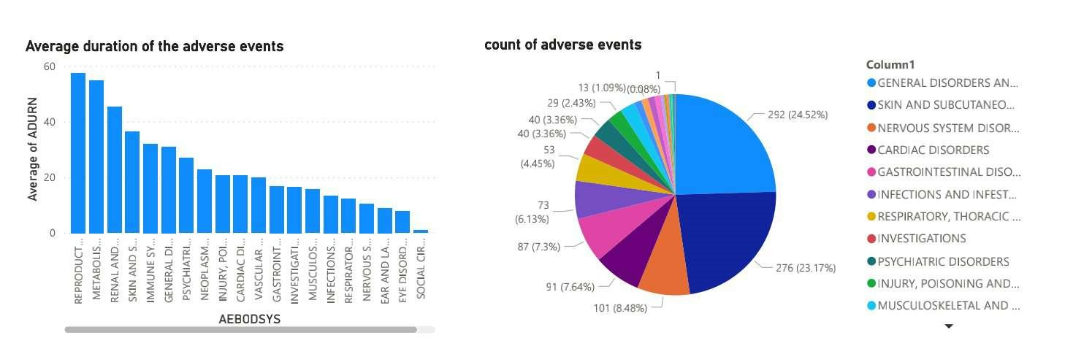
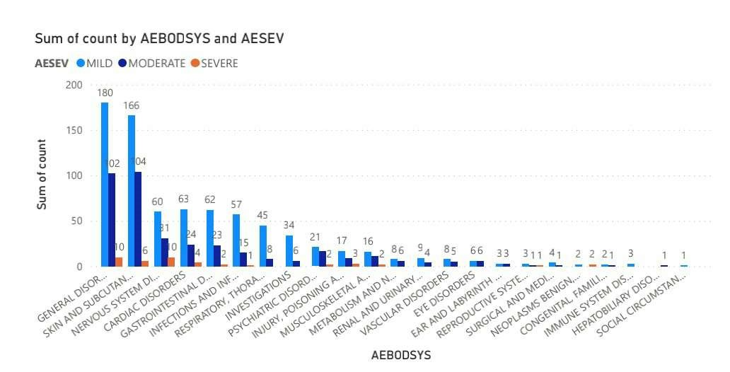
Overview of Treatment emergent Adverse Events

Slide 5
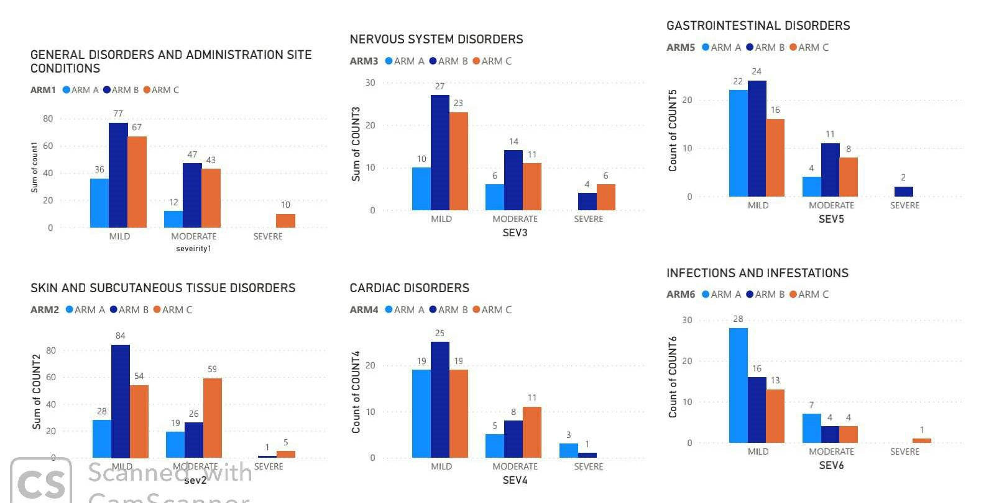
AE during on _ therapy by intensity

Slide 6
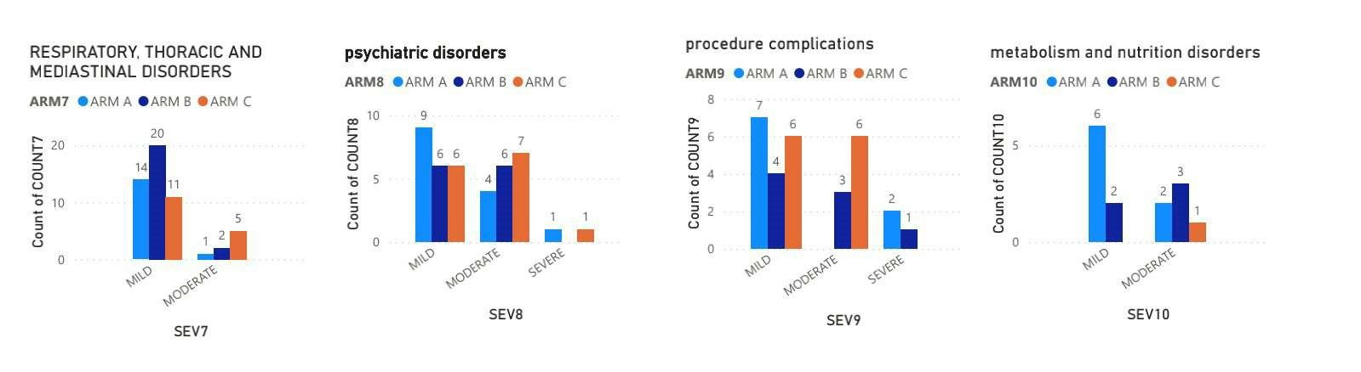

Slide 7
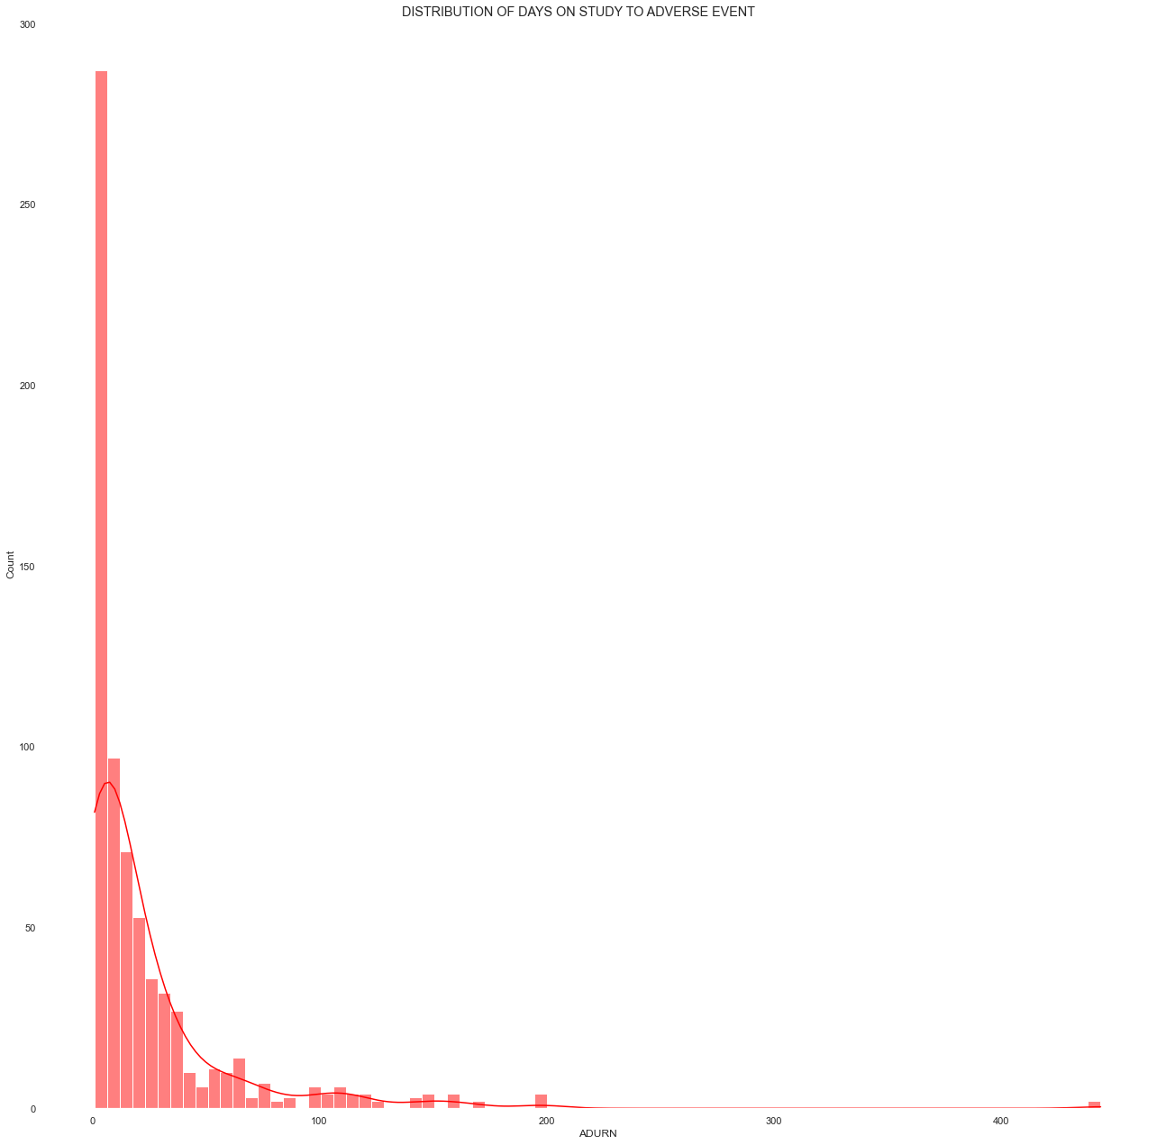
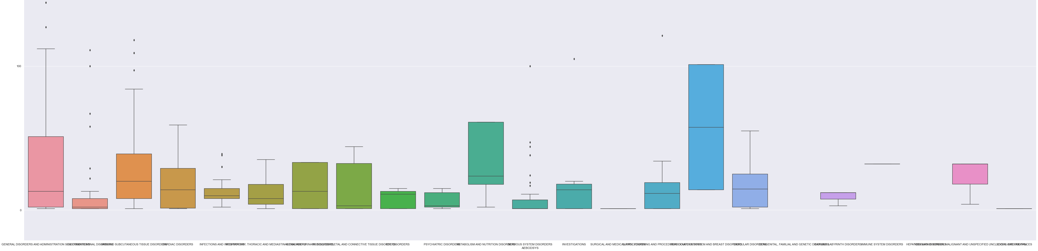
Distribution of days on study to adverse events

Slide 8
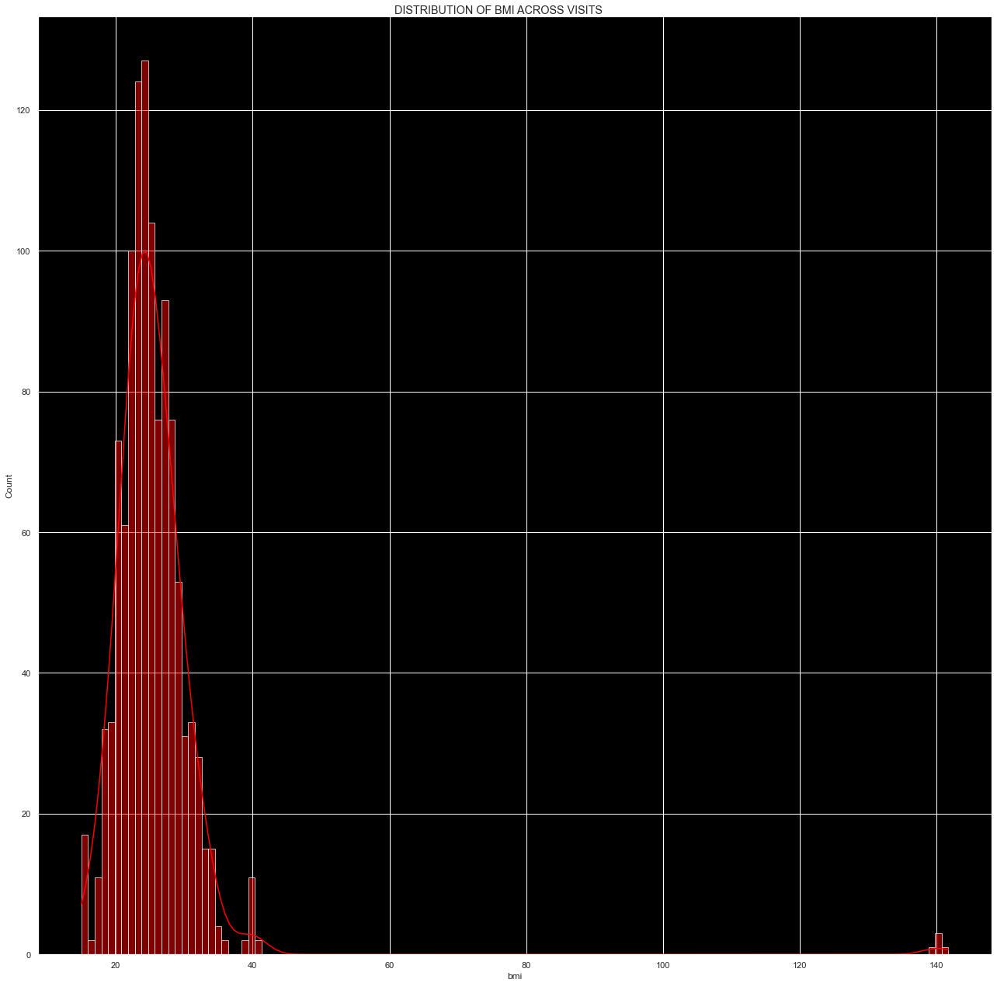
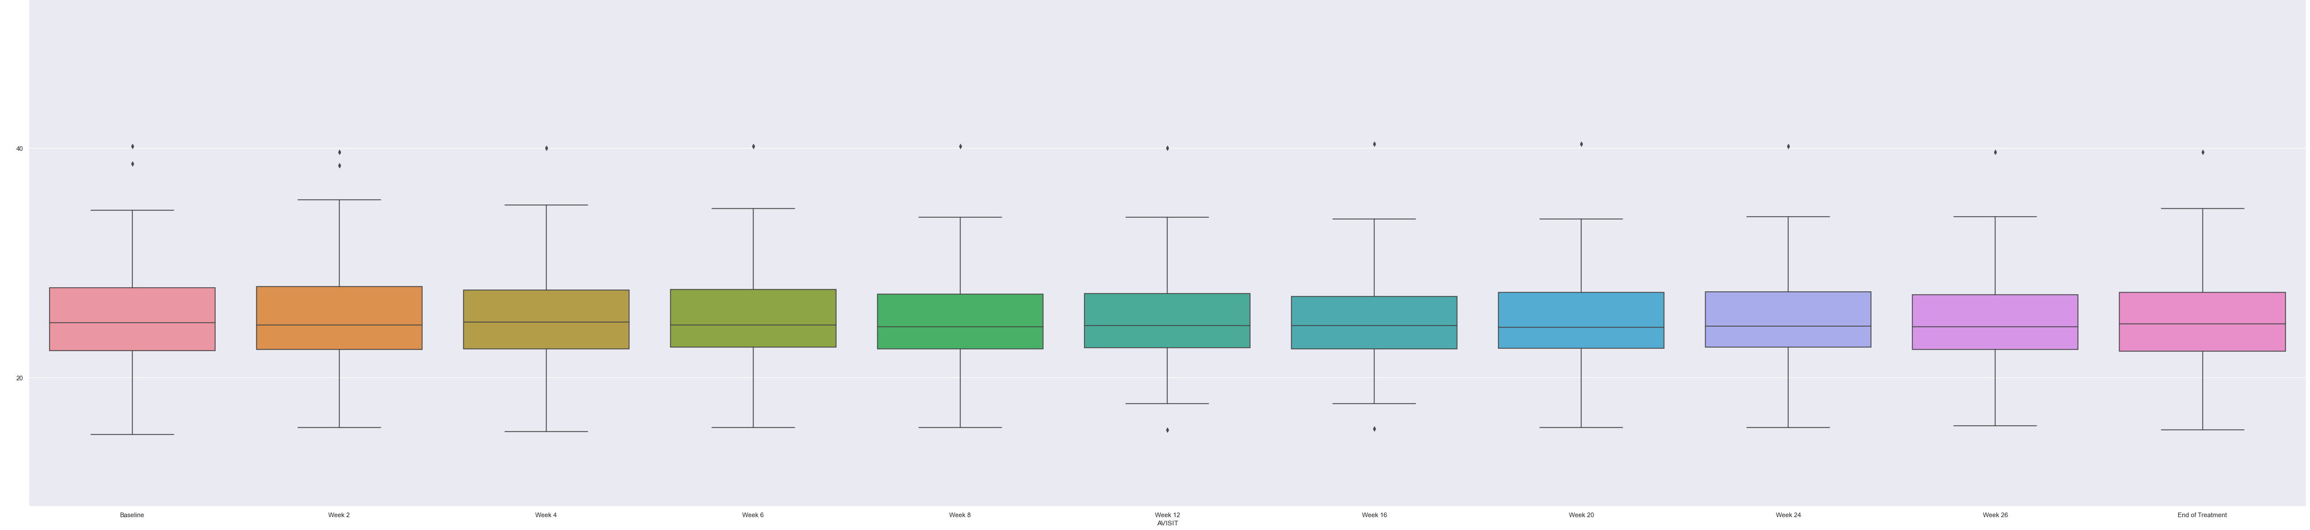
Distribution of BMI across visits

Slide 9
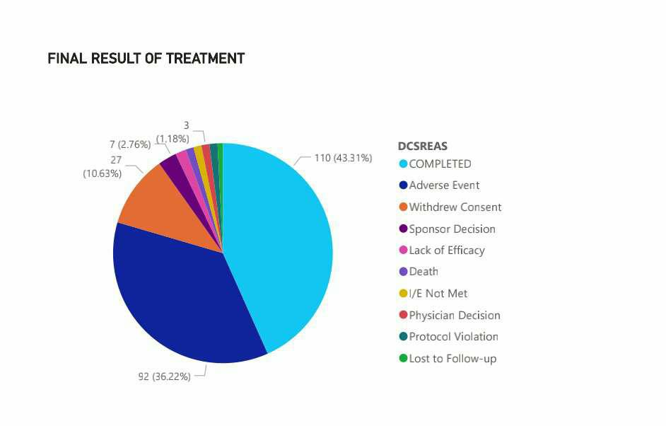
Final result of the treatment

Slide 10
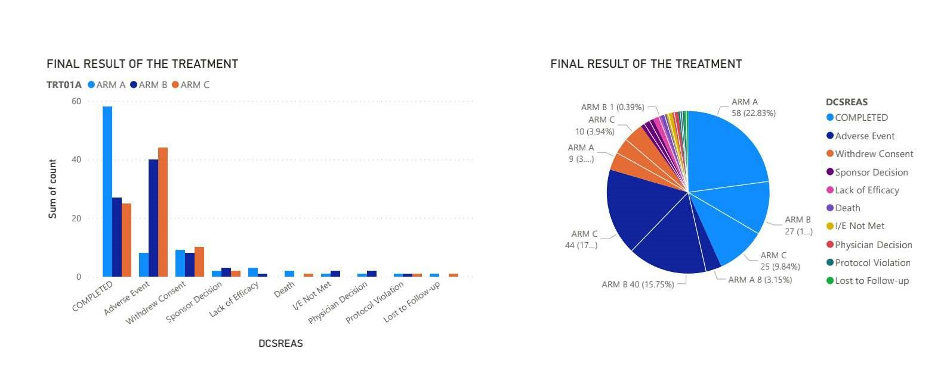
Final result of the treatment

Slide 11
CONCLUSION:
We have used python and power BI tools to manipulate and explore the data.
We used plots like barplot, histplot, distplot, BOX-plot, pie chart and Area chart for visualizing the data.
We found that distribution of BMI across visits follows normal distribution shows there is not much variance in BMI across visits.
We observed 24 kinds of adverse events occurred during the treatment.
General disorder adverse event has occurred most with 24.52% among all adverse events followed by skin disorder adverse event with 23%.
Reproductive system and breast disorders has highest average duration.
Found severity count for every adverse event.
We finally observed that 43% of the subjects have completed the treatment
and remaining percentage of subjects have discontinued because of various reasons
Like adverse events, physician decescion, death etc.
The majority of the subjects who received the treatment of ARMA completed the treatment.

